Slide 1
Bitcoin
Reported by ZeHai Su

Slide 2
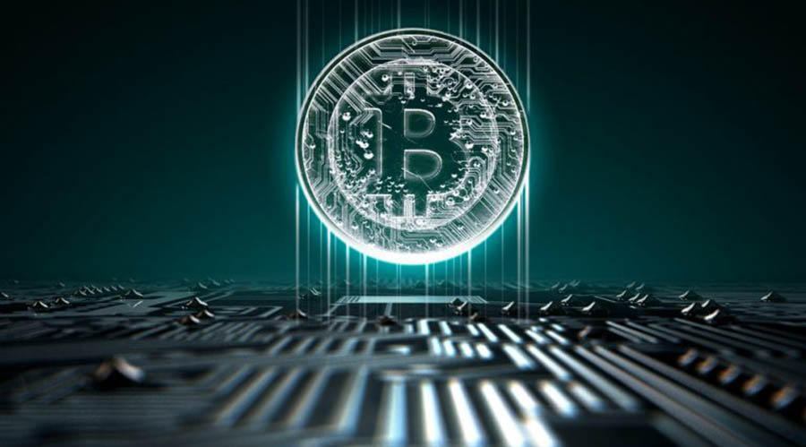
What is Bitcoin?
Bitcoin is a worldwide cryptocurrency and digital payment system called the first decentralized digital currency, as the system works without a central repository or single administrator.
It was invented by an unknown person or group of people under the name Satoshi Nakamoto and released as software in 2009.

Slide 3
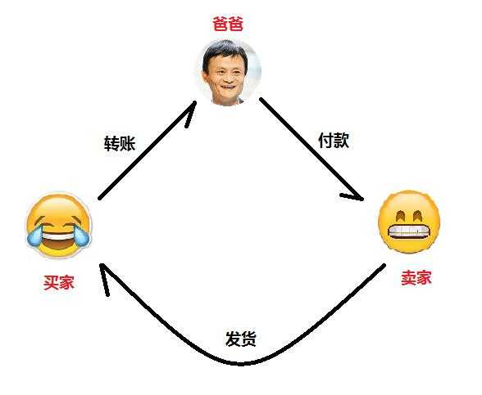
Centralized trading model
If you want to buy something from Taobao, the transaction process is: You pay Alipay - Alipay receipt your money and then inform seller to deliver goods- the seller deliver goods - you confirm the receipt - Alipay put the money to the seller.
The transaction between you and seller is around a third party ——Alipay. If the Alipay system crashes, it will cause the transaction failure.
The current currency, such as RMB and US dollars, belongs to centralized trading model, and the third party is government.

Slide 4
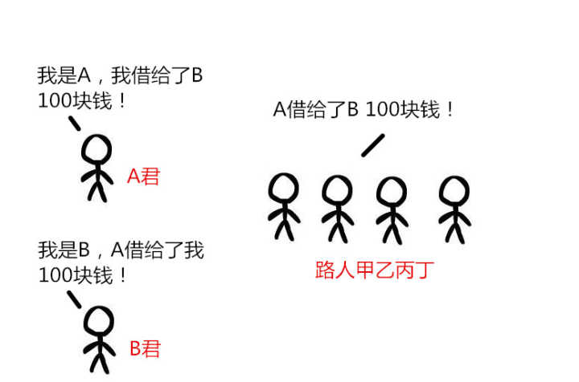
Decentralized trade model
In the decentralized trade model，it‘s going to be a lot simpler. You just need to exchange money and goods with the seller, and both of you claim to have done the deal. The decentralized trade model will save a lot of resources, make the whole transaction autonomous, simple, and eliminate the risk of centralized agent control.
Bitcoin belongs to the decentralized trade model. The system is peer-to-peer, and transactions take place between users directly, without a third party. These transactions are verified by network nodes and recorded in a public distributed ledger called blockchain(区块链).
However, without an authoritative central agent , how to ensure the accuracy and effectiveness of each transaction?
For ease of understanding , let’s do an example.
Among the crowd，A said “I lent B 100 dollars”. And then B said “A lent me 100 dollars”. At this point, the passers-by heard the news , so everyone wrote it down in notebook, "A lent B 100 dollars.“
Now a decentralized system has been established. This system doesn’t require a bank, a loan agreement or receipt. Strictly speaking, it does not even require long-term trust between people.(For example , if B changed his mouth ” I do not owe A money”. People will stand up and say “ I record that A lent you 100 dollars someday in my notebook.”)

Slide 5
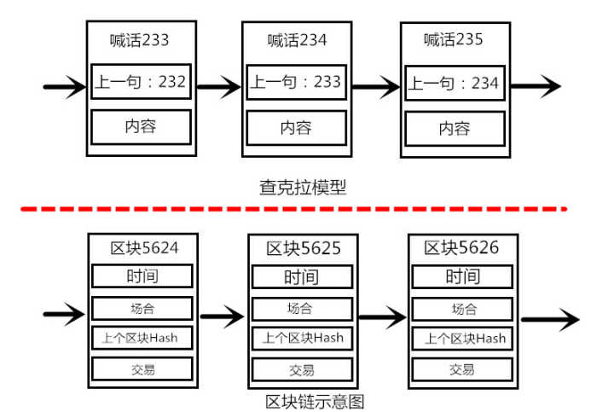
The problem of forgery
According to our decentralized trade model , let’s take fictional currency ——chakra as an example.
After a long time, I have created the chakra that has been circulating in this system, and everyone is beginning to recognize the chakra. But there were only 10 chakras in the system, and there was a bad guy, and he shouted in the crowd, "I have 10 chakras."!" What should we do? Did you directly record on your notebook that he had 10 chakras, so that everyone could forge a chakra?
In order to prevent the occurrence of this phenomenon, I decided on my chakra to create my chakra mark (more precisely, I was given I shouted that "I created 10 chakra" mark, such as mark is 001), so after every transaction when I shouted "I gave 1 chakra!" I need to add an extra sentence, "the source of the 1 chakra is the record of 001, and my sentence is marked as 002.
This rule solves the problem of forgery. In fact, the above model has become a simplified version of the first edition of bitcoin block chain protocol.

Slide 6
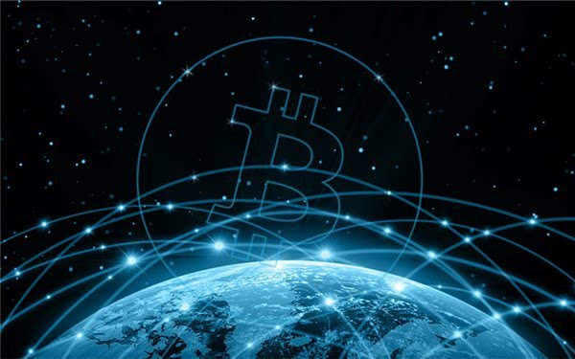
Blockchain
The blockchain is a public ledger that records bitcoin transactions. A novel solution accomplishes this without any trusted central authority: the maintenance of the blockchain is performed by a network of communicating nodes running bitcoin software. Transactions of the form payer X sends Y bitcoins to payee Z are broadcast to this network using readily available software applications. Network nodes can validate transactions, add them to their copy of the ledger, and then broadcast these ledger additions to other nodes. The blockchain is a distributed database – to achieve independent verification of the chain of ownership of any and every bitcoin amount, each network node stores its own copy of the blockchain.
Bitcoin point to point network stores all the history of the transactions in the block chain, and bitcoin transactions are “recording" on the block chain. The payer needs to digitally sign the transaction with his own private key to prove the ownership and approve the transaction. Bitcoin will be recorded in the recipient's address.

Slide 7
A reward for recording
For our chakra model, someone may ask ” Why should I help you to record ?” In order to encourage everybody to help me pass and recording, I decided to give the first one who heared I shouted and recorded in a notebook some reward—— 1 chakra for free.After you record this sentence, immediately to tell other people you have already recorded , make others give up to record this sentence.
When this rule is set, a certain number of people will appear in this system. They begin to erect their ears to monitor the sound of the surroundings to be the first one to record the transaction . Yeah , just like Bitcoin miner.
But what if two or more persons finishing the recording at the same time?
Let’s add a new rule : Everyone recording the transaction should take off his shoes and then take a pen with his feet, write in a regular script in a notebook! With this rule, it takes at least 10 minutes for each person to finish recoding. Due to the difficulty in writing with his feet, the time spent recording is different. So someone will finish it first and immediately tell other people he have already recorded . Others who is recording this sentence will stop writing and rewrite “ XX writed this sentence. The mask of last sentence is … ”

Slide 8
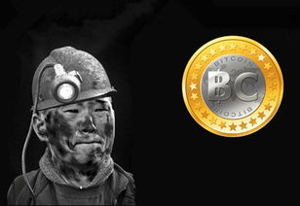
Mining and Bitcoin miner
Bitcoin miner is a member of a bitcoin network that everybody has rights of participation . In order to obtain a new issue of bitcoin(like the award), members need to solve mathematical problem(like writing with his feet) through computer equipment, this process is called “mining“.
Miners keep the blockchain consistent, complete, and unalterable by repeatedly verifying and collecting newly broadcast transactions into a new group of transactions called a block. Each block contains a cryptographic hash of the previous block.

Slide 9
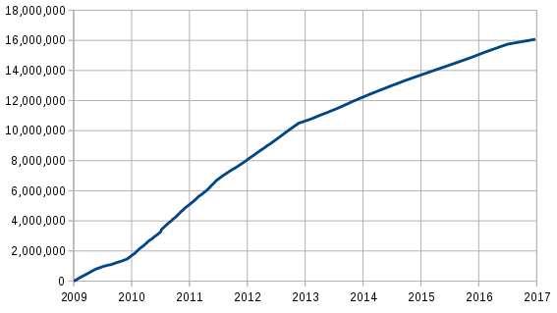
Supply
The successful miner finding the new block is rewarded with newly created bitcoins and transaction fees. As of 9 July 2016, the reward amounted to 12.5 newly created bitcoins per block added to the blockchain. To claim the reward, a special transaction called a coinbase is included with the processed payments.All bitcoins in existence have been created in such coinbase transactions. The bitcoin protocol specifies that the reward for adding a block will be halved every 210,000 blocks (approximately every four years). Eventually, the reward will decrease to zero, and the limit of 21 million bitcoins will be reached in 2140; the record keeping will then be rewarded by transaction fees solely.
In other words, bitcoin's inventor Nakamoto set a monetary policy based on artificial scarcity at bitcoin's inception that there would only ever be 21 million bitcoins in total. Their numbers are being released roughly every ten minutes and the rate at which they are generated would drop by half every four years until all were in circulation.
Total bitcoins in circulation

Slide 10
How many dollars can be exchanged for one bitcoin?

Slide 11
THANKS

